Slide 1
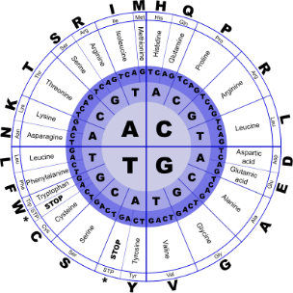
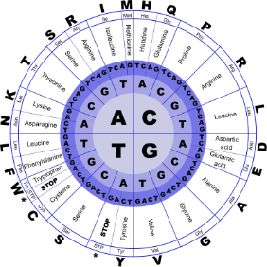


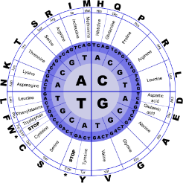
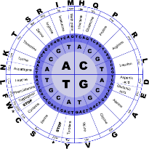
Fundamentals of Programming II
Vector

Slide 2
Vectors
Holds a set of elements, like an array
Flexible number of elements - can grow and shrink
No need to specify size when defined
Automatically adds more space as needed
Defined in the Standard Template Library (STL)
Covered in a later chapter
Must include vector header file to use vectors
#include <vector>

Slide 3
Vectors
Can hold values of any type
Type is specified when a vector is defined
vector<int> scores;
vector<double> volumes;
Can use [] to access elements

Slide 4
Vectors
Define a vector of integers (starts with 0 elements)
vector<int> scores;
Define int vector with initial size 30 elements
vector<int> scores(30);
Define 20-element int vector and initialize all elements to 0
vector<int> scores(20, 0);
Define int vector initialized to size and contents of vector finals
vector<int> scores(finals);

Slide 5
Growing a Vector’s Size
Use push_back member function to add an element to a full array or to an array that had no defined size
// Add a new element holding a 75
scores.push_back(75);
Use size member function to determine number of elements currently in a vector
howbig = scores.size();

Slide 6
Removing Vector Elements
Use pop_back member function to remove last element from vector
scores.pop_back();
To remove all contents of vector, use clear member function
scores.clear();
To determine if vector is empty, use empty member function
while (!scores.empty()) ...

